Slide 1
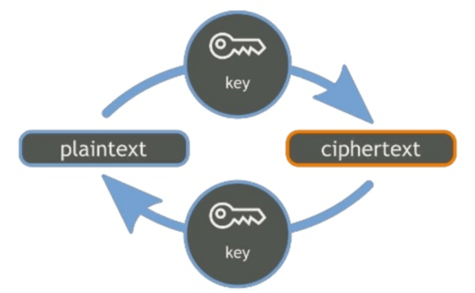
Cryptography

Slide 2
Authentication
Authentication is the process of
Assuring CONFIDENTIALITY – Only those authorized can view. Authentication can be for access or decryption.
Assuring NON-REPUDIATION – Actions are tied to the users that performed them, or that messages are sent from the person who apparently sent it.

Slide 3
Basic cryptography
Encryption is a way of transforming data to keep it secret by transforming it from it’s decrypted state (plaintext) to an encrypted state (cipher text) and back to it’s decrypted state. It is meant to be reversible. It’s use requires the sharing of keys.
Example: Asymmetric-key, symmetric-key
Encoding is a way of obfuscating data or transforming it for suitable consumption. It is meant to be completely and transparently reversible. It does not use keys – it is merely a translation of data. All computed data is encoded – machine code to common parlance is encoding.
Example: Base64, ASCII, Unicode, Hexidecimal
Hashing is a way of validating data to ensure it hasn’t been altered, or of permanently obfuscating data. It is meant to be irreversible. It does not utilize keys. It is meant to be deterministic, not random, meaning you should arrive at the exact same result every time the same data is computed. Hashing can be improved by salting – adding additional random data to pad out the hash.
Example: MD5, SHA1

Slide 4
Why encryption
Because encryption is part of good security. It’s also often mandatory for:
HIPAA
FERPA
PCI
Many organizations also have it written into their internal policies, and many mandate it due to it being a requirement for cyber-incident insurance.

Slide 5
Why encryption
Encryption is a concern wherever data resides. Many application have app-level encryption. Microsoft Office, Adobe PDFs, etc.
At the network layer, we have secure protocols like TLS, IPSec, PPTP, etc.
Disk encryption for both FDE (Full Disk Encryption) and PDE (Partial Disk Encryption)
We will also look at volume-based: BitLocker, VeraCrypt
And file-based: EFS, PGP/GPG

Slide 6
History – Caesar
Substitution Cipher
Mapping of each letter in alphabet to another one
Plain text → Cipher text
Decoding is done by access to mapping algorithm

Slide 7
A Cryptogram
U VBKF BRCBIN XFRM MVBM B CDEBG VBN MVF OUWVM MD MOFBM MVF NLATFZM DX VFO BWF CUMV BEAUWLUMI LGMUR, QFOVBQN, NVF QBNNFN UGMD MVF OFBRE DX DKFO GUGFMI. MVFG UM UN AFMMFO NVF AF ZBGYUY CUMV VFONFRX BGY MVF CDORY.
VFRFGB OLAUGNMFUG

Slide 8
History – Vigenere
16th century cipher based on keyword
Polyalphabetic substitution
Plain text + keyword → cipher text
Assigns number to each letter (a=0, b=1,…)
Add value of each letter in keyword to value of letter in plain text
Repeat with next letters until done, repeat
Unbreakable for ~ 300 years

Slide 9
Encrypted Message
p llgs hphlmz jpwh alle o dsxlb oed evl vtrva xz eflee evl wfmxlge zt oic lul atev hqmtubmej iuxtw dlvsldz wsp dhwdpg prez hoi cposq zq ccic ywuiej hoiy th pw mphaic dvl fp nouhto kpxs ssywpwt hro evl azczk
lpwsue cfpprdespr

Slide 10
History – WWII
German/Japanese encryption Machines
Letter substitution devices
Complex substitution that changes as message is typed
Broken after capture
Windtalkers
Navajo Indians mapped native language to English
Not broken

Slide 11
History – One-Time-Pad
Military communications between soldiers and HQ
Random numbers 0-25
2 Copies: 1 in field, 1 at HQ
Shift letter of message by number on pad
Used into 1980s

Slide 12
Why encryption is important
Encryption is the last line of defense – it’s security at the point of “they have the data, now we need to make sure they can’t use it.”
There are downsides, though.
Adds another layer of complexity
Have to manage keys
Doesn’t solve all potential issues at that stage (malware, account compromise)
Increases likelihood of corruption (and makes backups more difficult.)

Slide 13
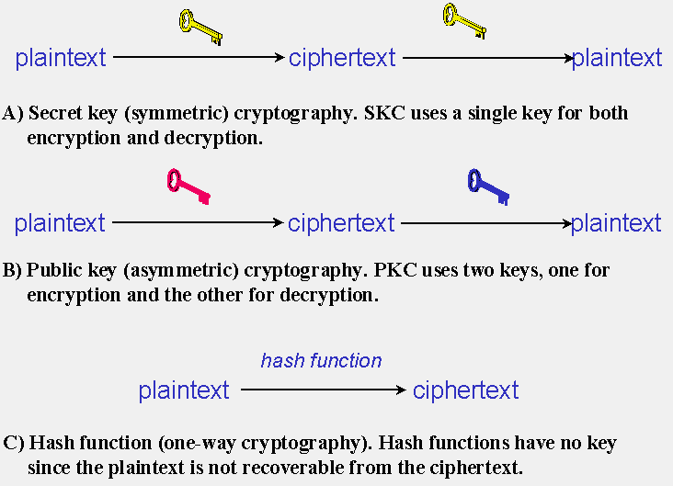
Symmetric Key & asymmetric key

Slide 14
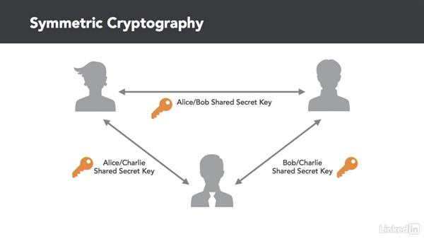

Slide 15
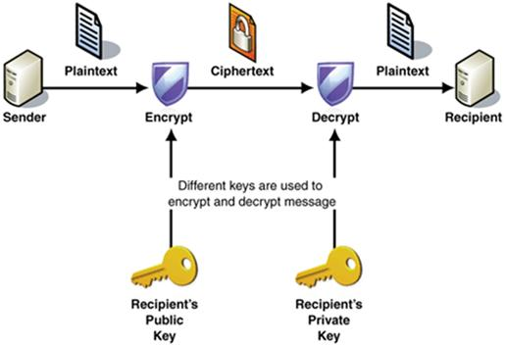
asymmetric key

Slide 16
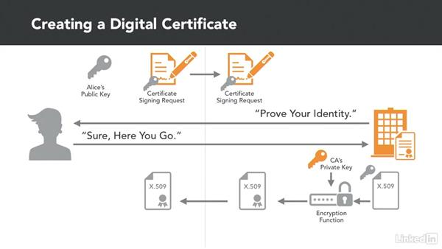
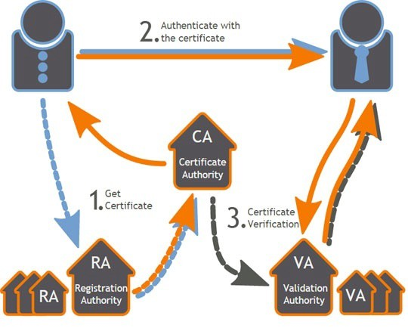

Slide 17
FDE: BitLocker
If you are looking to do full disk encryption on Windows systems, BitLocker is not a bad way to go because it is an encryption solution that is easily centrally supportable.
It’s native, requiring only the appropriate hardware of OS version to operate.
There are PowerShell cmdlets available to manage it.
It’s configurable with Group Policy
The keys can be stored in Active Directory (or in files on a server) and secured separately through a TPM managers group.
Options for end users – you can secure with TPM, USB, PIN, etc.

Slide 18
FDE: BitLocker
It should be noted that the use of a TPM chip has been controversial.
Some argue that a TPM chip essentially provides complete control over a system to software and hardware vendors, and could be used as DRM.
As you will see, a TPM chip supersedes all other functions, and builds out profiles using hardware/software checks.
It would be a trivial matter to, for example, permanently disable a system running a pirated copy of Windows.

Slide 19
TPM Chips
It stands for Trusted Platform Module, and it is essentially a separate trusted coprocessor (a permanent hardware key) and it performs a number of important security functions (if you opt to utilize them.)
This chip is what protects secrets and performs cryptographic functions – having it separate and isolated as a coprocessor protects it from compromise. It creates, stores, and manages keys and performs digital signature operations.
Software cryptography has gotten very strong, but hardware+software will always be stronger.

Slide 20
FDE: BitLocker
To put it in the simplest possible terms, what a TPM chip will do is build out a profile of the system when it’s enabled: Hardware connected and even potentially software installed.
It uses that to create a digital signature of the device. Each time the disk is decrypted it will validate the signature. If there is a change to the profile, the signature will not match and the disk will not decrypt. This means that if someone were to remove the drive from the system the data wouldn’t be readable.
Furthermore, this check occurs before even the BIOS is loaded, giving few opportunities for an injection or compromise.

Slide 22




FDE: BitLocker
TPM Only
“What it is”
Protects Against:
Most SW attacks
Vulnerable To:
Hardware attacks
User Must:
N/A
No user impact
Ease of Deployment / Maintenance
TPM + PIN
“What it is + what you know”
Protects Against:
Many HW attacks
Vulnerable To:
Hardware attacks
User Must:
Enter PIN to boot
TPM + USB
“What it is + what you have”
Protects Against:
HW attacks
Vulnerable To:
Stolen USB key
User Must:
Protect USB key
USB Only
“What you have”
Protects Against:
HW attacks
Vulnerable To:
Stolen USB key
No boot validation
User Must:
Protect USB key

Slide 23
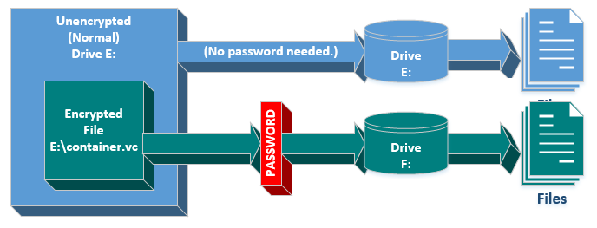
PDE
Not many years ago, many people used TrueCypt for the PDE needs. However, that was broken by law enforcement and ever since then VeraCrypt has been the main go-to for PDE. This is also possible in Windows natively by creating a VHD and encrypting it with BitLocker.
Partial Disk Encryption is a way to have a file system left unencrypted, but provide a secure container for certain files.

Slide 24
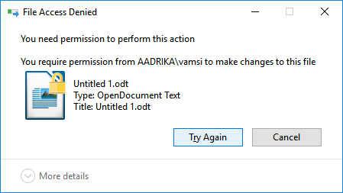
File-Based encryption
EFS and PGP are file-based encryption.
EFS is native to Windows now, and essentially generates a file encryption key based upon the user profile that encrypts the file. That profile can roam (say, for example, a domain account across multiple computers) but if an unauthorized profile attempts to open the file, they will receive and error that looks like this:

Slide 25
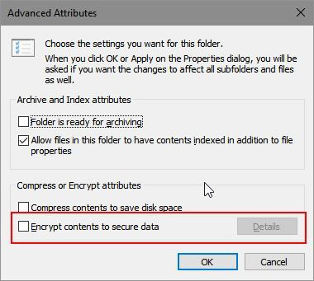
File-Based encryption
With EFS, the process is as simple as editing the file attributes, can be mandated with Group Policy.
In a domain environment, the FEK keys can also be managed with GP, and data recovery agents created.
However, I do have a downside here. It has been my experience from experimenting with EFS is that it can be a huge PITA once it’s enabled. Management (especially on a large scale) can be a problem, and rolling back can be difficult. It also complicates backups. By the time you’re done granting permissions across the organization for access, it’s become virtually worthless.
I would still use it, but situationally.

Slide 26
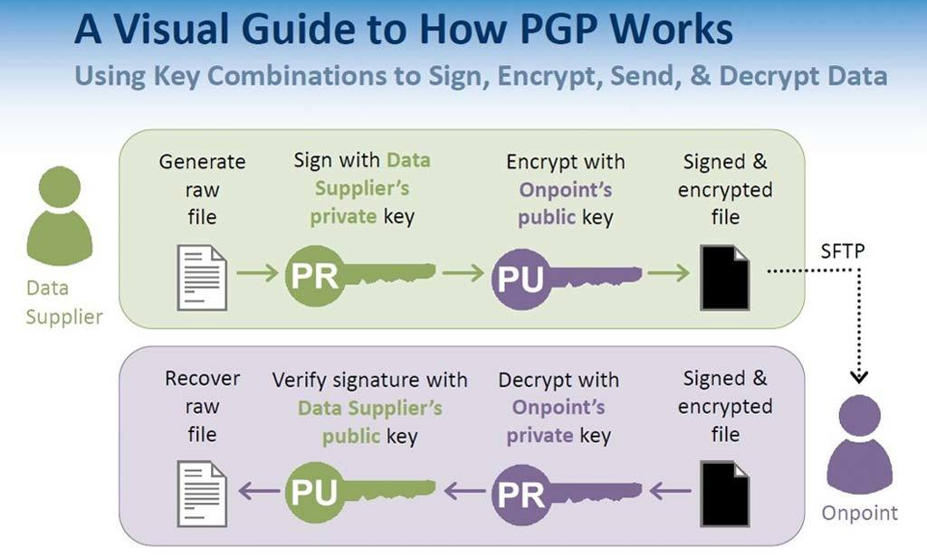
Pretty Good Privacy
PGP – Pretty Good Privacy and GPG – GNU Privacy Guard are a way of encrypting files/messages using standard key exchange methods.
The sender of a message signs the message with their private key and encrypts it with the recipients public key.
The recipient decrypts the message with their private key, and validates it with the sender’s public key.
This way, the message is secret thanks to encryption, and there is non-repudiation thanks to the signature.
As with any type of key based encryption, protecting the keys is paramount.

Slide 27
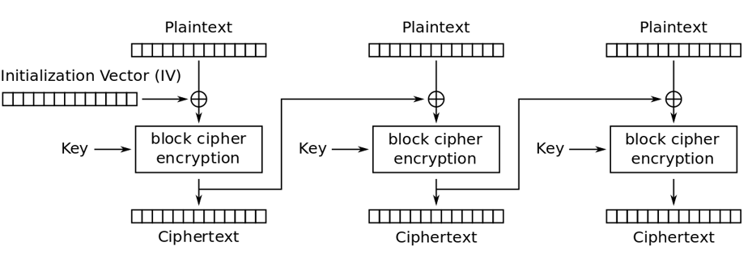
Cipher-block chaining
Cipher block chaining is an operation where sequences of bits are encrypted as a unit (or block) with a key. And a string of randomish data known as an initialization vector. The ciphertext is then used as the IV to encrypt the next block, and so on, and so on.

